Slide 1
Characterizing Differentially Expressed Genes
Transcriptomics by Manpreet Katari

Slide 2
LEARNING OBJECTIVES
Upon completing this module, you will be able to:
1. Identify GO-terms that are enriched in a gene list.
2. Group genes based on similar expression levels or expression patterns
3. Evaluate how well a gene fits in its cluster group
Notes:
Find the changing genes, 2) group them together using clustering, and 3) do enrichment analysis

Slide 3
Genome-wide analysis results in gene lists
RNA-seq/Microarray experiment -> analysis -> list of genes
Differentially expressed genes
Cluster of highly correlated genes
Experiment 4
Experiment 10
Experiment 5
Experiment 6
Experiment 1
Experiment 7
Experiment 2
Experiment 3
Experiment 8
Experiment 9
Gene 1
Gene 2
Gene 3
Gene 4
Gene 5
…
…
Gene 10,000
Notes:
[Introduction video]
SCRIPT:
When analyzing high-throughput data, like Microarray experiment, the end result is often a list of genes.
Differentially expressed genes.
Cluster of highly correlated genes.
A natural next step is to identify the commonality between the genes in the list.
Similar annotations
Same Pathway
Components of a Protein Complex

Slide 4
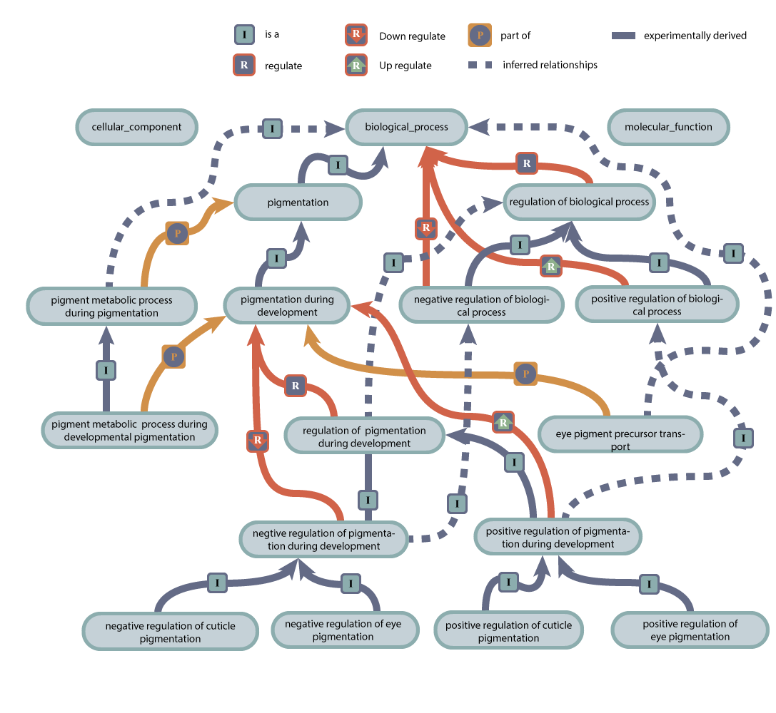
Genome-wide analysis results in gene lists
Next: commonality between the genes in the list
Similar annotations
Same Pathway
Components of a Protein Complex
Notes:
[Introduction video]
SCRIPT:
When analyzing high-throughput data, like Microarray experiment, the end result is often a list of genes.
Differentially expressed genes.
Cluster of highly correlated genes.
A natural next step is to identify the commonality between the genes in the list.
Similar annotations
Same Pathway
Components of a Protein Complex

Slide 5
Gene lists as a discovery tool
What is so special about our Gene List?
Group genes based on similar expression patterns to learn more about them.
Example 1: cluster of correlated genes ->
Align genes’ promoter regions in the cluster ->
look for conserved Transcription Factor Binding sites
Example 2: Find an “unknown” gene in a list of genes ->
if only up-regulated by a given treatment ->
provide a putative function for unknown gene

Slide 6
Gene set enrichment
Often when we characterize this list of genes, we use statistics to show that the property or annotation is significantly over-represented compared to if the list was created randomly.
Two of the common statistical methods are :
Hypergeometric Test
Fisher’s exact test

Slide 8
Gene Ontology
“The Gene Ontology (GO) project is a collaborative effort to address the need for consistent descriptions of gene products in different databases.”
“The GO project has developed three structured controlled vocabularies (ontologies) that describe gene products in terms of their associated biological processes, cellular components and molecular functions in a species-independent manner.”
“A gene product might be associated with or located in one or more cellular components; it is active in one or more biological processes, during which it performs one or more molecular functions.”
http://geneontology.org/docs/introduction-to-go-resource/

Slide 9
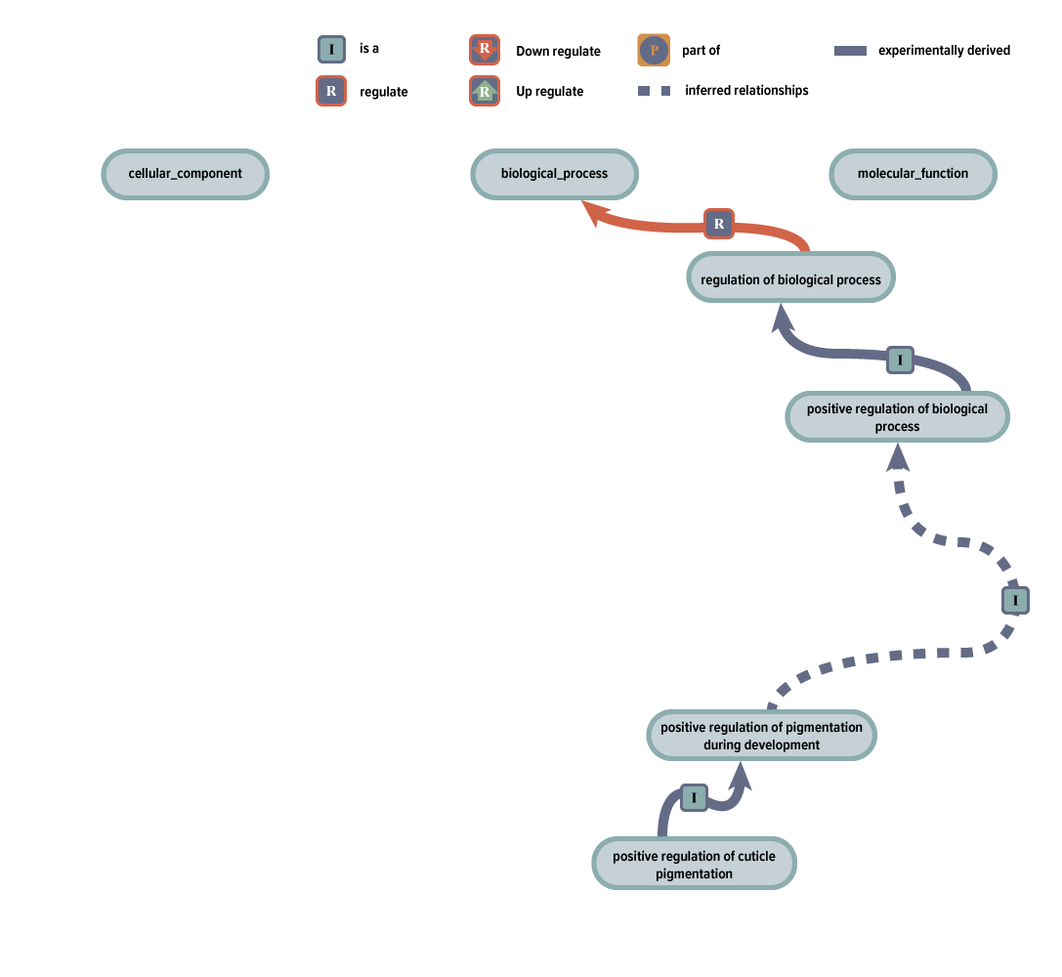
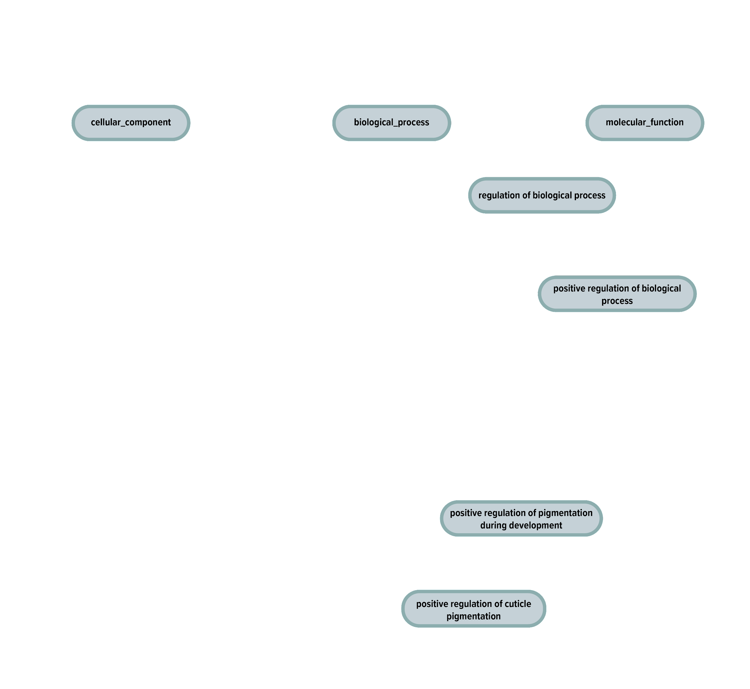
GO is a directed acyclic graph
Notes:
Video 1
Make a drag&drop including 7 ovals: “cellular component”, “biological process”, molecular function”, “pigmentation”, “regulation of biological process”, “negative regulation of biological process”, “positive regulation of biological process”.
1) Show only the top three nodes ( cellular component, biological process, and molecular function.)
2) show some of the other nodes -> regulation of biological process, positive regulations of process, positive regulation of pigmentation during development, and position regulation of cuticle pigmentation.
3) show the arrows that connect the nodes that appeared in part 2.
4) Show all nodes and edges.
Legend: I = is a , p = part of , R is regulate, Green R is Up Regulatie, Red R is Down Regulate, dotted lines are inferred relationships.

Slide 10
GO-term enrichment using Hypergeometric test
Notes:
Video 1,
1) Show only the top three nodes ( cellular component, biological process, and molecular function.)
2) show some of the other nodes -> regulation of biological process, positive regulations of process, positive regulation of pigmentation during development, and position regulation of cuticle pigmentation.
3) show the arrows that connect the nodes that appeared in part 2.
4) Show all nodes and edges.
Legend: I = is a , p = part of , R is regulate, Green R is Up Regulatie, Red R is Down Regulate, dotted lines are xomputationally derived, solid lines are experimentally derived.

Slide 12
Normalizing your data
>source(http://bioconductor.org/biocLite.R)
>biocLite(“simpleaffy”)
>library(simpleaffy)
#copy the .cel.gz files to your working directory.
#Your working directory should also contain a file called covdesc describing the experimental design.
>data.raw<-read.affy(“covdesc”)
>data.mas5<-call.exprs(data.raw, “mas5”)
>sample1<-detection.p.val(data.raw[,1], call=TRUE)
>qc<-qc(data.raw, data.mas5)
>plot(qc)
Notes:
Video 2 Writing the code in R studio

Slide 13
Creating a list of differentially expressed genes
>pair<-pairwise.comparison(data.mas5, “disease”, c(“control”, “polycystic_ovary_syndrome”), data.raw)
>pair.filt<-pairwise.filter(pair, min.present.no=3, present.by.group="T", fc=log2(1.5), tt=0.05)
>#pair and pair.filt have slots which can be accessed by @
>pair.filt@means
>pair.filt.sorted <- pair.filt[order(pair.filt@tt),]
>gene.list = row.names(pair.filt.sorted@means)
Notes:
Video 2

Slide 14
Annotating the probeset
>source(“http://bioconductor.org/biocLite.R”)
>biocLite(“annotate”)
>biocLite(“hgu133a.db”)
>biocLite(“GO.db”)
>library(“hgu133a.db”)
>library(“annotate”)
>library(“GO.db”)
>hgu133a()
>get(gene.list[20], env=hgu133aGENENAME)
>get(gene.list[20], env=hgu133aSYMBOL)
>gene.GO<-getGO(gene.list, data=“hgu133a”)
>gene.GO[[20]][[1]]
>ERAP1.BP<-getOntology(gene.GO[[20]], ontology=“BP")
>getGOTerm(ERAP1.BP)
Notes:
Video 2

Slide 15
Getting literature information
>gene.list.abstracts<-pm.getabst(gene.list, “hgu133a”)
>gene.list.abstracts[[20]][1:5]
Notes:
Video 2

Slide 16
To check for available slots use slotNames()
Name | Description
mean | Mean values for each experimental factors
fc | Fold change of the means
tt | p-value between the factors
calls | Detection p-value for each probeset on each array
group | Name of the factor that was compared
members | List containing the levels that were compared
pData | phenoData for the members that were compared
calculated.from | Original expression that was being compared.
Notes:
Rise

Slide 18
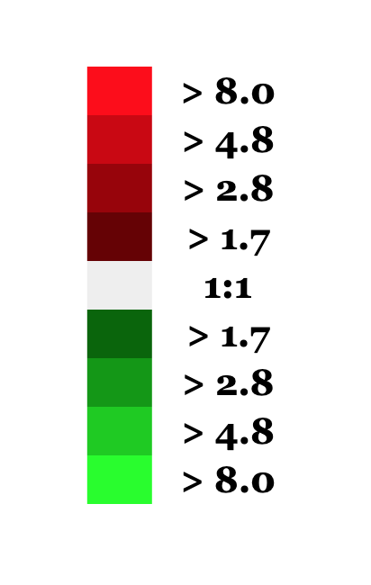
Clustering Transcriptomic Data
Is there a better way to organize this data?
Experiment 4
Experiment 10
Experiment 5
Experiment 6
Experiment 1
Experiment 7
Experiment 2
Experiment 3
Experiment 8
Experiment 9
Gene 1
Gene 2
Gene 3
Gene 4
Gene 5
…
…
Gene 10,000
Notes:
Video 3 Intro to clustering

Slide 19
Root of clustering problems: a matrix
 | gene 1 | gene2 | gene 3
gene 1 | 1 | 0.5 | 0.8
gene 2 | - | 1 | 0.6
gene 3 | - | - | 1
It describes all the pairwise relationships (distances) between the elements you are trying to group (genes in this case)
But how do you define distance?
Notes:
Video 3

Slide 20
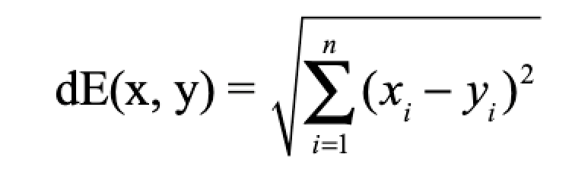
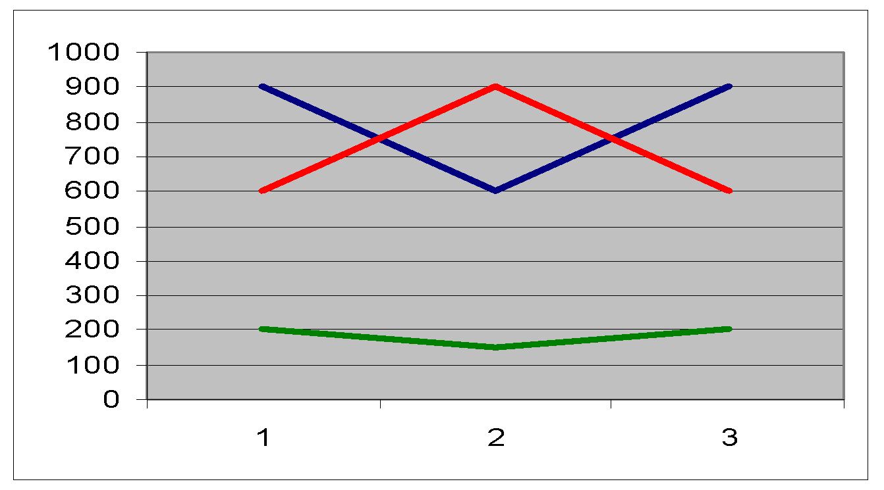
Euclidean distance
Implication for gene expression: the magnitude of expression values will determine distances
520
gene expression
1090
experiment

Slide 21
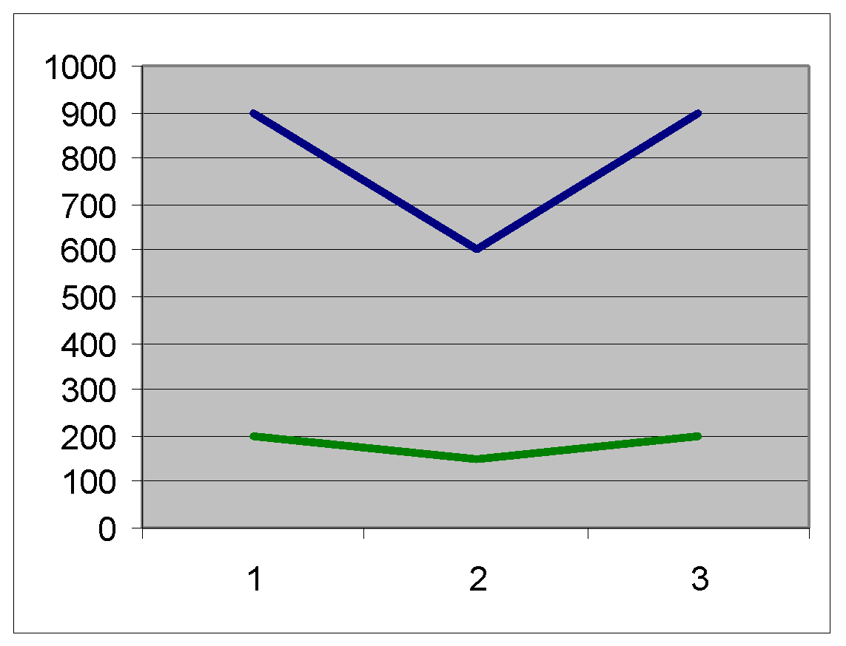
Variance and covariance
x₁ x₃
hybridization signal
x₂
y₁ y₃
y₂
experiment
Variance measures dispersion from a mean value
Intuitively, covariance is the measure of how much two variables vary together
(x₁-x_{b})²+ (x₂-x_{b})²+(x₃-x_{b})²
(x₁-x_{b}) (y₁-y_{g})+……
n-1
n-1

Slide 22
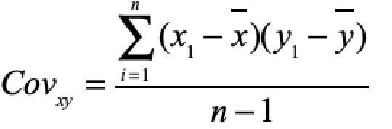
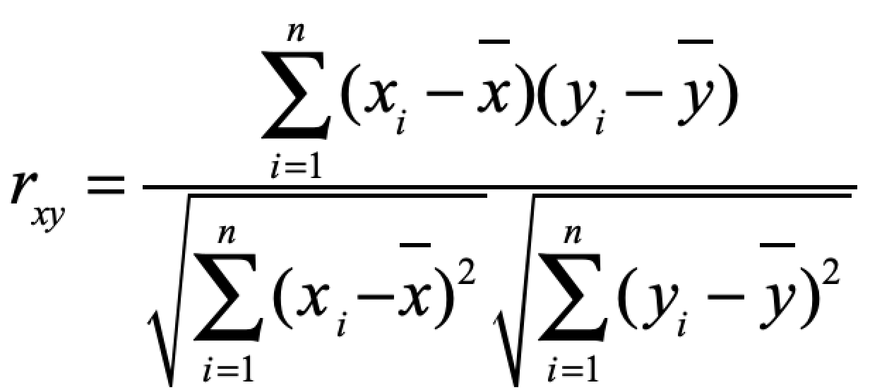
Covariance and correlation 1
Start with the concept of covariance
Normalize the measure by taking the variance of two measurements.
Pearson correlation has the nice property of varying between -1 and 1
Pearson correlation coefficient
Notes:
Formulae have to be fixed, sorry! - the square root of VarX * VarY should be changed to just sdX * sdY. It is more accurate.

Slide 23
Covariance and correlation 2
Implication for gene expression: the shape of gene expression responses will determine similarity
-1
gene expression
1
experiments

Slide 25
Now organize matrix into groups
Experiment 4
Experiment 10
Experiment 5
Experiment 6
Experiment 1
Experiment 7
Experiment 2
Experiment 3
Experiment 8
Experiment 9
Gene 1
Gene 2
Gene 3
Gene 4
Gene 5
…
…
Gene 10,000
 | gene 1 | gene2 | gene 3
gene 1 | 1 | 0.5 | 0.8
gene 2 | - | 1 | 0.6
gene 3 | - | - | 1

Slide 26
Clustering approaches
Agglomerative (near points/clusters are joined)
“bottom up” approach
Notes:
Video 4

Slide 27
Hierarchical clustering: example
 | gene 1 | gene2 | gene 3
gene 1 | 1 | 0.5 | 0.8
gene 2 | - | 1 | 0.6
gene 3 | - | - | 1
Experiment 4
Experiment 10
Experiment 5
Experiment 6
Experiment 1
Experiment 7
Experiment 2
Experiment 3
Experiment 8
Experiment 9
Gene 1
Gene 2
Gene 3
Gene 4
Gene 5
…
…
Gene 10,000

Slide 28
Hierarchical clustering: example
1
3
Find cells with the shortest distance (e.g. highest correlation)
Group the two genes
Recalculate distances from joined group to rest of matrix
Find next shortest distance
Repeat 3-4 until done

Slide 29
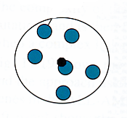
Some linkage methods
Single linkage
Complete linkage
Centroid linkage
Average linkage
Notes:
Animations have to be fixed

Slide 31
Clustering approaches
Divisive: partitioning methods

Slide 32
K-means: Example, k = 3
Step 1: Make random assignments and compute centroids (big dots)
Step 2: Assign points to nearest centroids
Step 3: Re-compute centroids (in this example, solution is now stable)

Slide 33
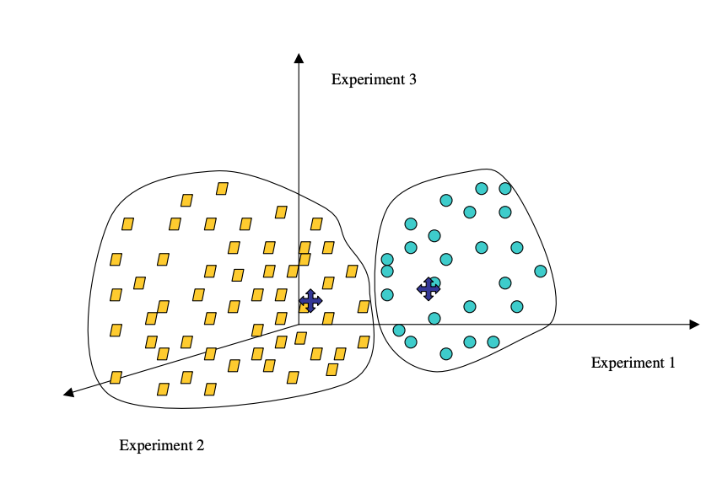
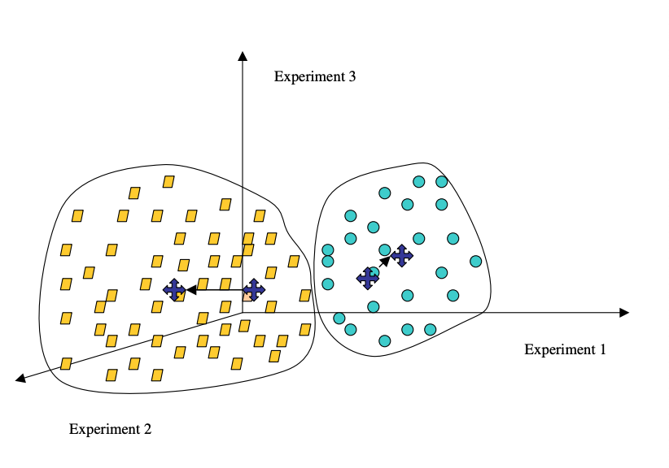
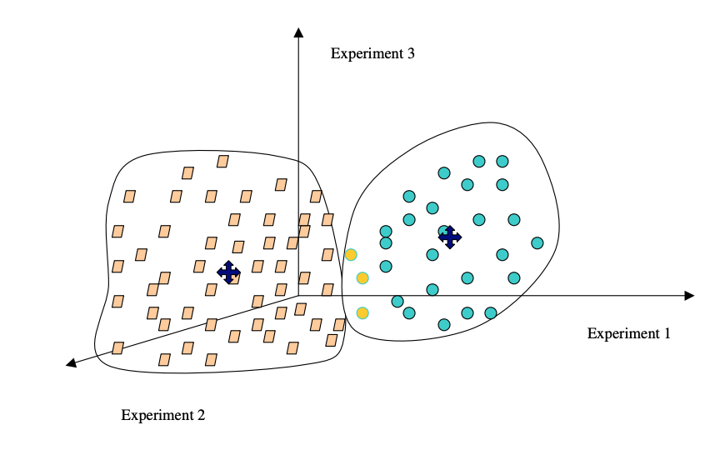
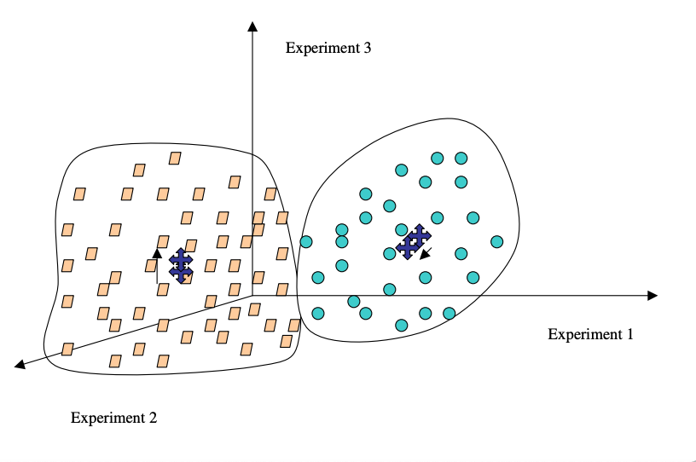
K means in action: creates round clouds
Source: Sorin, Drăghici. Statistics and Data Analysis for Microarrays Using R and Bioconductor, Second Edition by Chapman and Hall/CRC Series: Chapman & Hall/CRC Mathematical and Computational Biology, 2016
Notes:
1: Top Left
2: Top Right
3: Bottom Left
4: Bottom Right
Take image from the book, Ch 7 “Clustering” p. 585

Slide 34
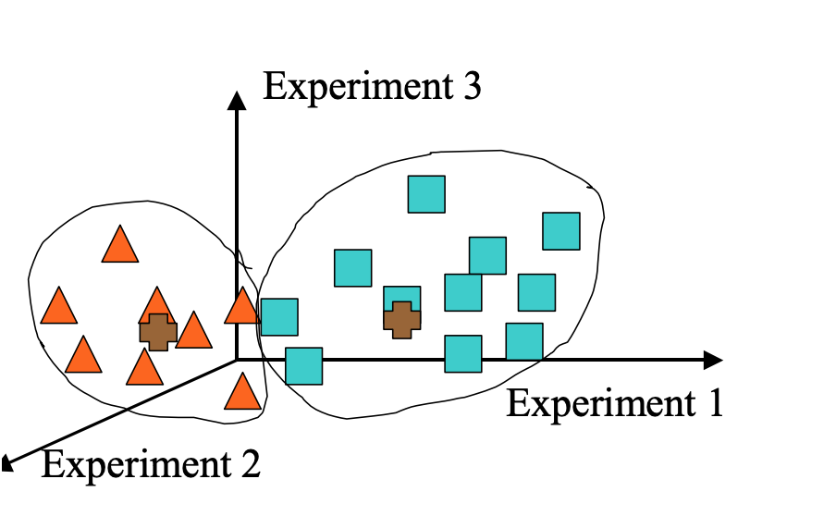
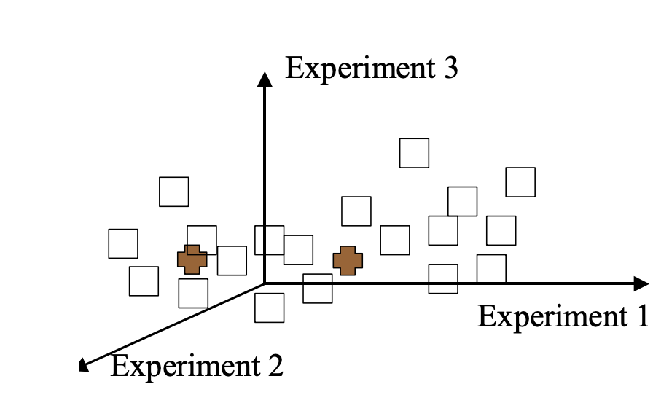
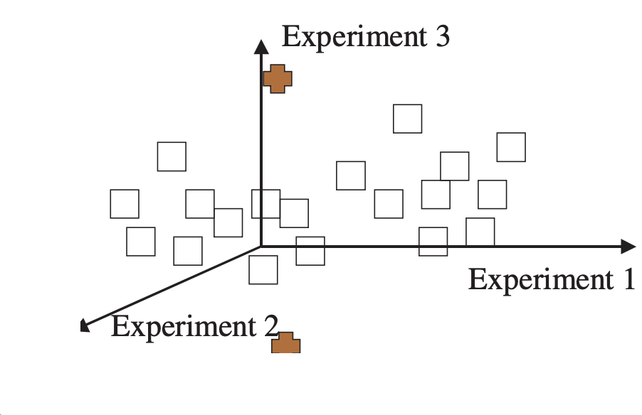
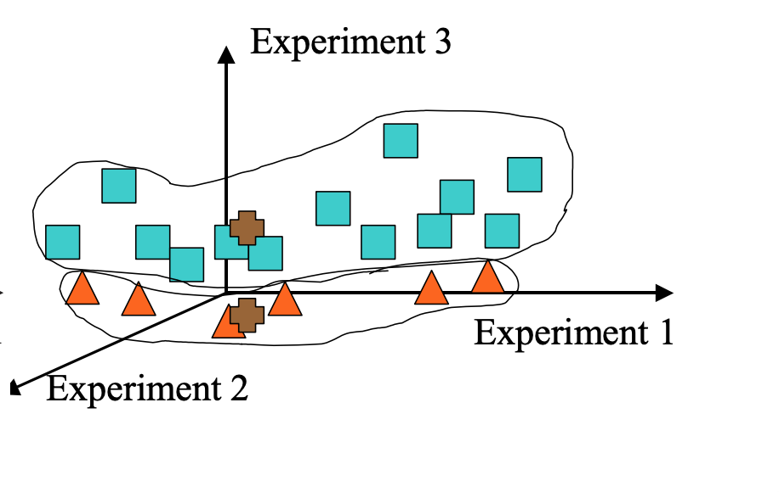
K-means weaknesses: can give you a different result each time with exactly the same data?
Source: Sorin, Drăghici. Statistics and Data Analysis for Microarrays Using R and Bioconductor, Second Edition by Chapman and Hall/CRC Series: Chapman & Hall/CRC Mathematical and Computational Biology, 2016
Notes:
[Show the white points first, then the brown points, then show areas around red triangles and blue squares]
Take image from the book, p.586
Remake in AI, and bring in each layer at a time
Also, in Rise make an animated GIF

Slide 36
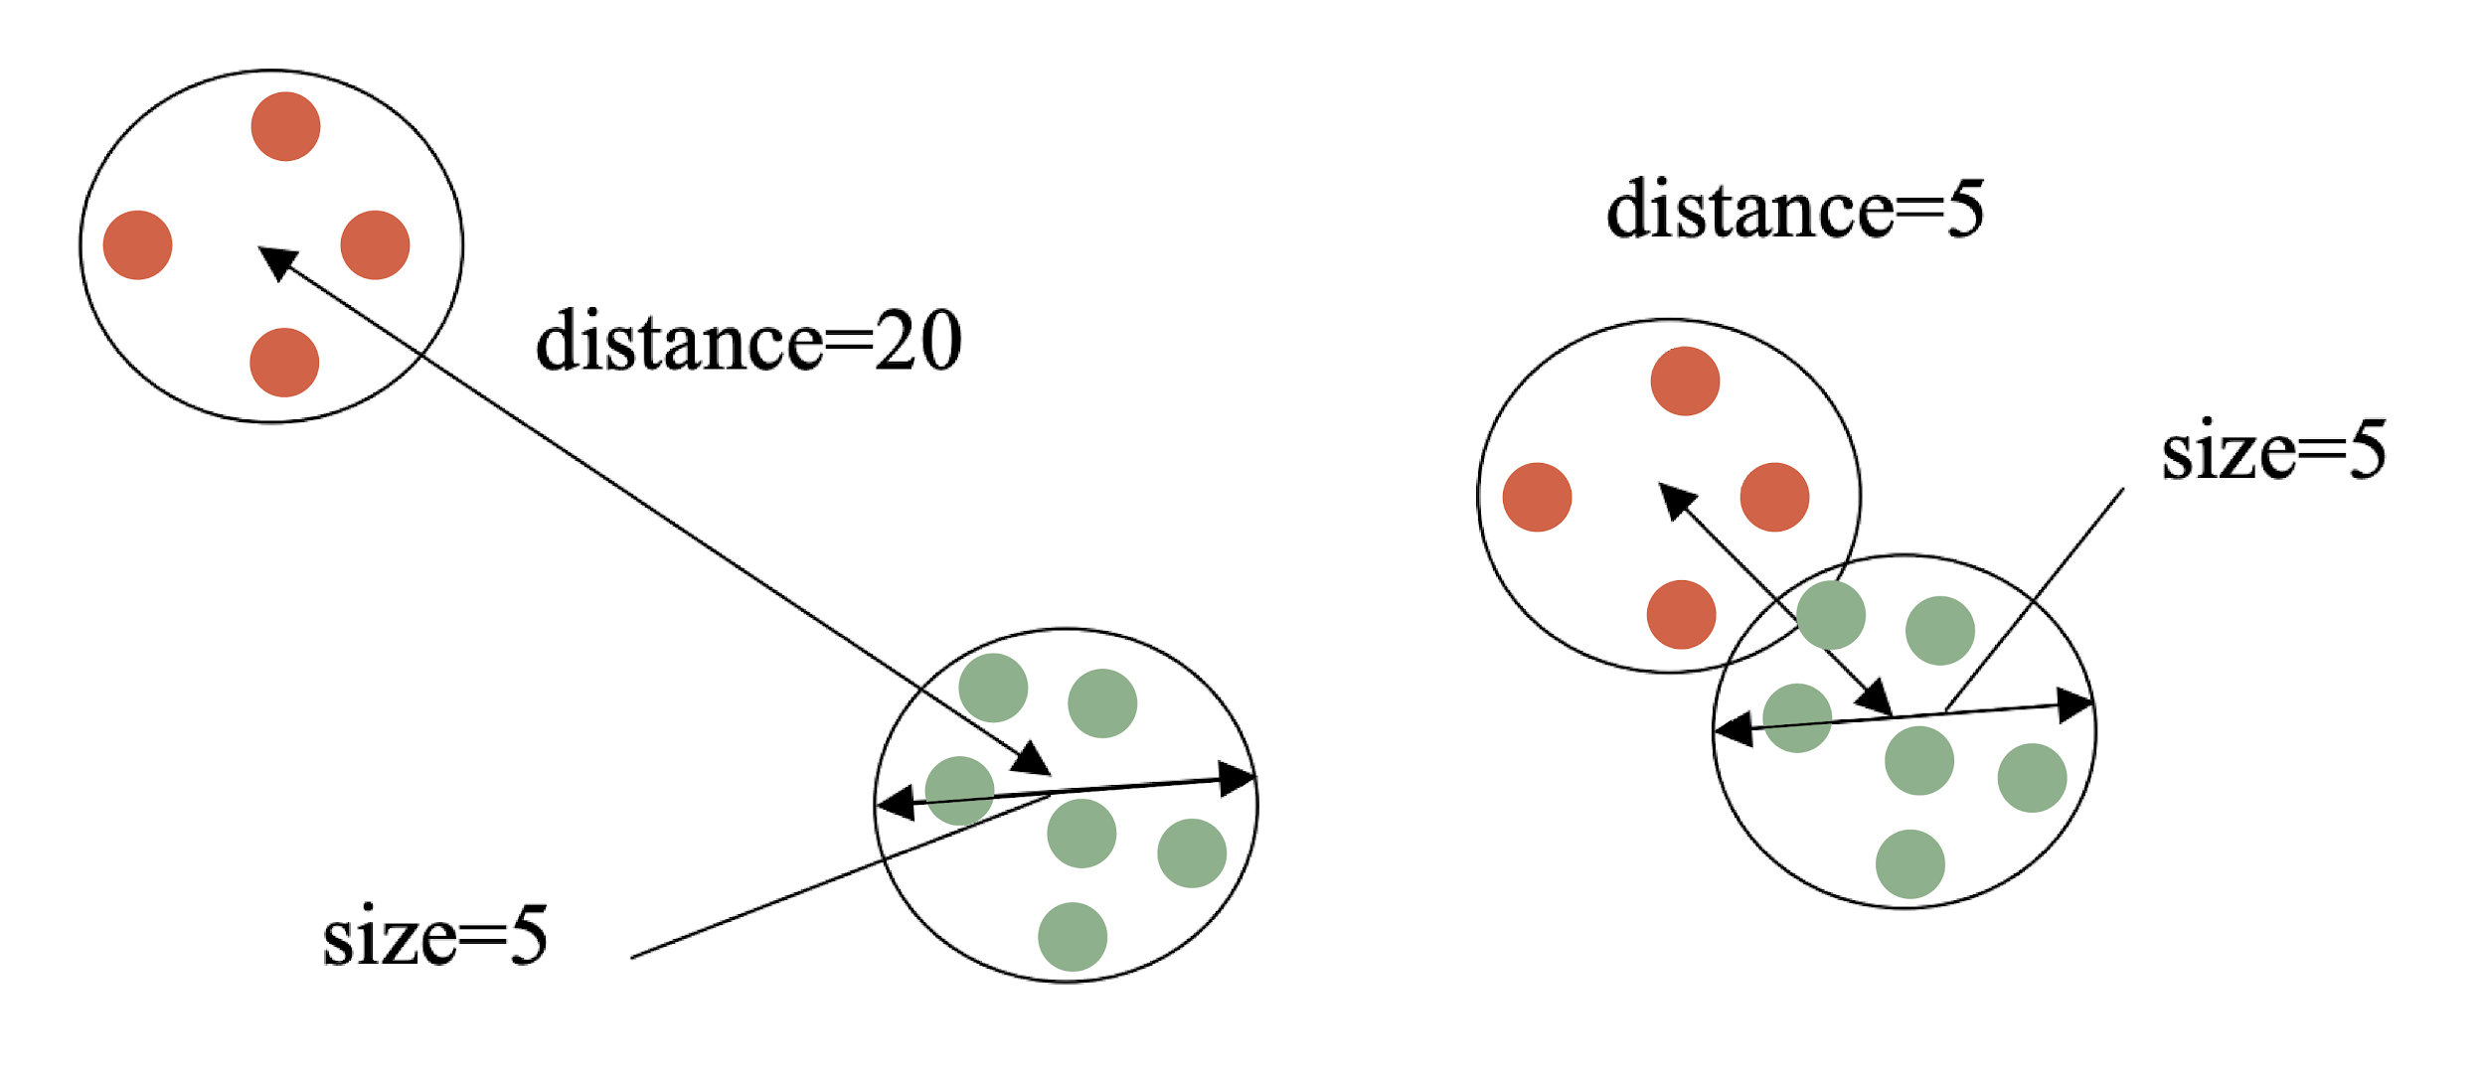
Judging the quality of a cluster
The idea is to classify distinct groups: other methods seek to directly optimize this trait in classification
Source: Sorin, Drăghici. Statistics and Data Analysis for Microarrays Using R and Bioconductor, Second Edition by Chapman and Hall/CRC Series: Chapman & Hall/CRC Mathematical and Computational Biology, 2016
Notes:
Take image from the book
p.587

Slide 37
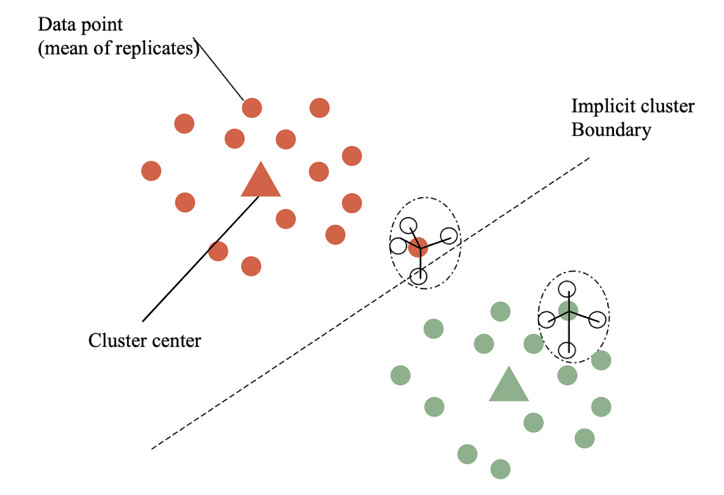
Measuring the quality of clusters
This guy has a low a_{i} and a big b_{i} -> high Silhouette value
Will lead to low or negative Silhouette values
Silhouette width
Sil_{i} = (b_{i}-a_{i})/max(a_{i},b_{i})
a_{i}-average within cluster distance with respect to gene i
b_{i}-average between cluster distance with respect to gene i
Notes:
Take image from the book
p.590

Slide 38
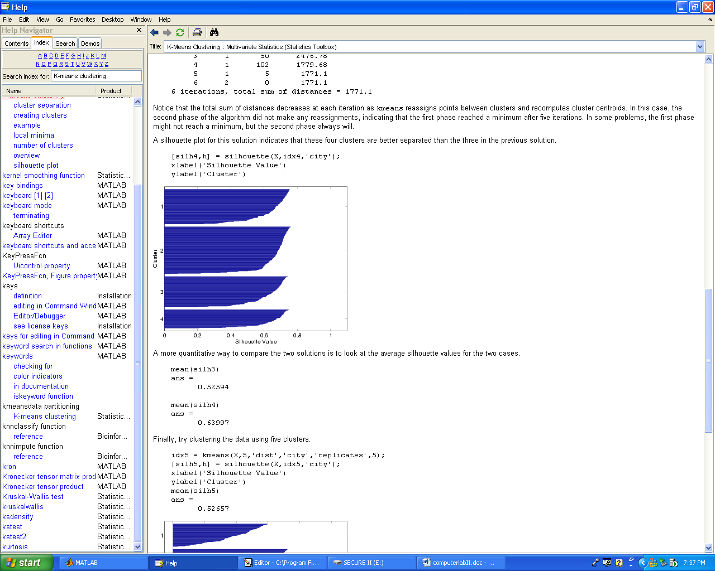
Silhouette plot

Slide 39
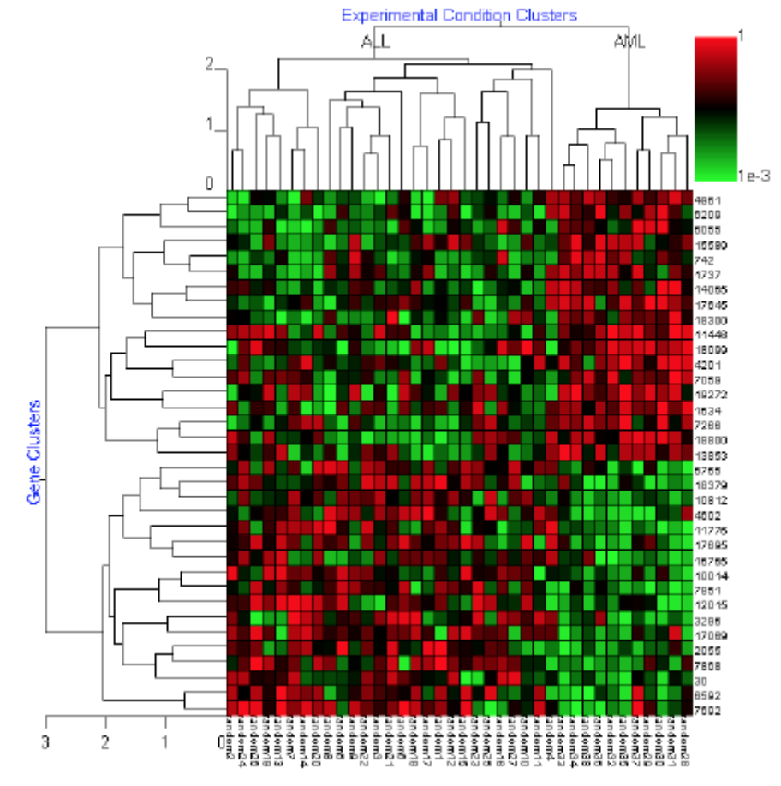
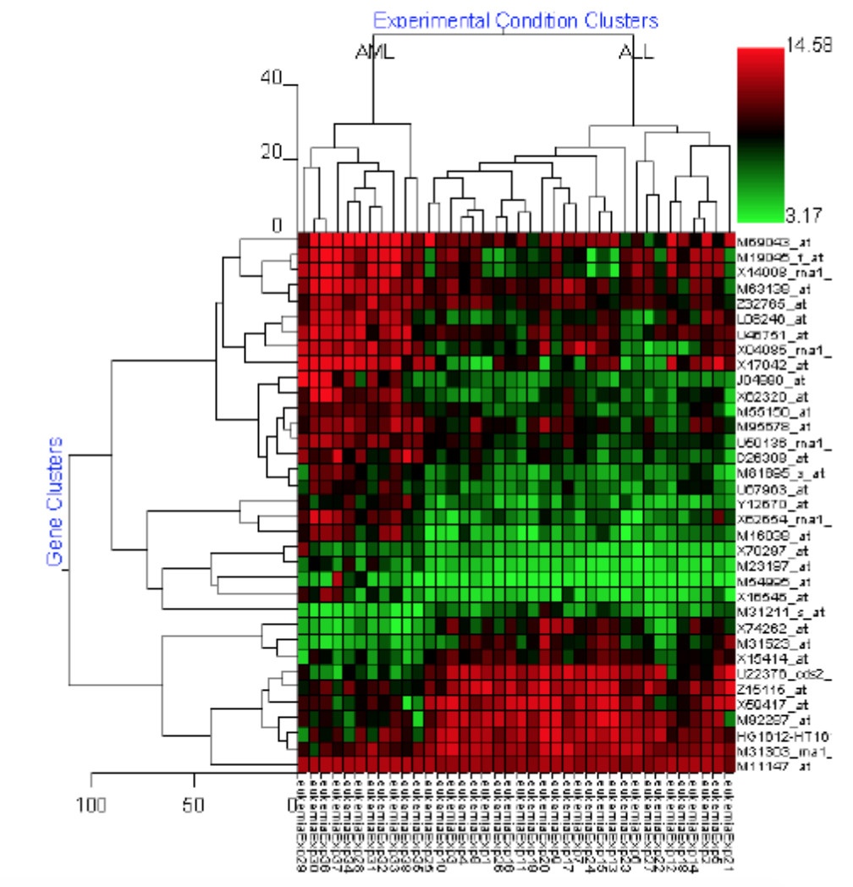
Interpreting clusters
Take Home Message:
You Can Cluster Anything You Want and Anything in the Right Format Will Cluster.
It Doesn’t Make it Relevant.
Source: Sorin, Drăghici. Statistics and Data Analysis for Microarrays Using R and Bioconductor, 2016
Notes:
End 6 Video 6,
p.581

